Slide 1
NEO4J CYPHER TUTORIAL WITH PYTHON
Export Neo4j Graph Data Into Pandas DataFrame
Tutorial 75

Slide 2
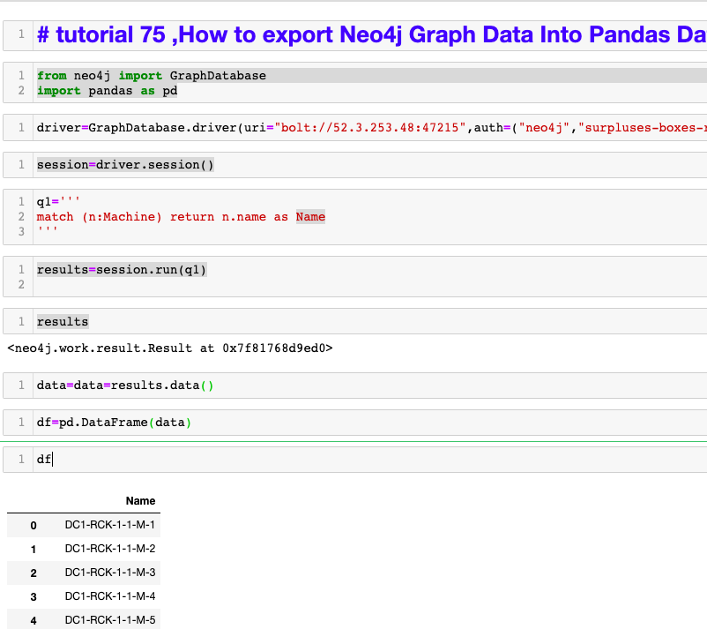
How to export Neo4j Graph Data Into Pandas DataFrame
How to export Neo4j Graph Data Into Pandas DataFrame

Slide 3
How to export Neo4j Graph Data Into Pandas DataFrame
https://sandbox.neo4j.com/

